Slide 1

Sentiment Analysis
-Harshita Asnani

Slide 2
What is Sentiment Analysis?
Sentiment analysis (or opinion mining) uses natural language processing and machine learning to interpret and classify emotions in subjective data.
A sentiment analysis system for text analysis combines natural language processing (NLP) and machine learning techniques to assign weighted sentiment scores to the entities, topics, themes and categories within a sentence or phrase
Sentiment analysis is often used in business to detect sentiment in social data, gauge brand reputation, and understand customers

Slide 3
Types of Sentiment Analysis
Fine-grained Sentiment Analysis
Emotion detection
Aspect-based Sentiment Analysis
Multilingual sentiment analysis

Slide 4
Importance of Sentiment Analysis
It’s estimated that 80% of the world’s data is unstructured, in other words it’s unorganized. But it’s hard to analyze, understand, and sort through, not to mention time consuming and expensive.
Sentiment analysis, however, helps businesses make sense of all this unstructured text by automatically understanding, processing, and tagging it
Main Advantages are
Sorting Data at Scale
Real-Time Analysis
Consistent criteria

Slide 5
How it works
Sentiment analysis uses various Natural Language Processing (NLP) methods and algorithms The main types of sentiment analysis algorithms used include:
Rule-based: these systems perform sentiment analysis based on a set of manually crafted rules.
Automatic: systems rely on machine learning techniques to learn from data.
Hybrid systems combine both rule-based and automatic approaches.

Slide 6
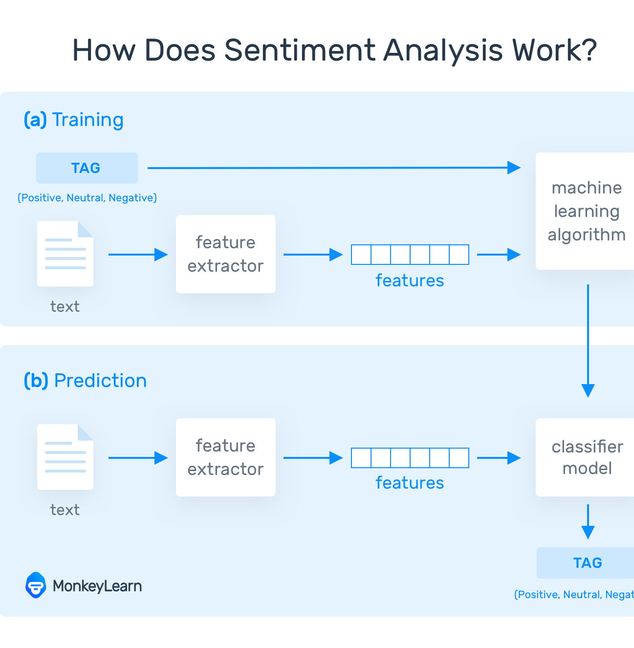
Steps for Automatic Sentiment Analysis

Slide 7
Feature extraction from text
Feature extraction for any text for the task of sentiment Analysis uses following steps:
Data Cleaning
Tokenization
Lemmatization (optional)
Stop words removal(optional)
Vectorization
How we decide to proceed with these tasks is mostly dependent on the type of data we have.

Slide 8
Tokenization
Assembly language (the language of Machines) is a language of numbers and is very different from human languages. To analyze texts written in human languages it is important to represent them in computer-recognizable form i.e. numbers. The computer further counts these numbers. The process of grouping characters as tokens initiate the process of counting is known as Tokenization. Thus, tokenization prepares the data for counting.
Consider the text :"Have a good day" the tokens for this text is ['Have','a','good','day']

Slide 9
Vectorization
The processes of representing all the characters of a text document in the form of vectors is known as vectorization.Vectorization takes care of how we should proceed with counting the data.
Vectorization creates a vocabulary of all the tokens present in set of documents and further represents text as numeric vector of all documents.
Types of Vectorizations:
Boolean Vectorizer
Count Vectorizer
TfIDF Vectorizer

Slide 10
Types of Vectorizations
The boolean vectorizer represents just the presence or absence of a word from vocabulary in the document
The count vectorizer represents the number of times a word from vocabulary appears in the document
The TFIDF(term frequency-inverse document frequency) vectorizer stands for is a statistical measure that evaluates how relevant a word is to a document in a collection of documents.

Slide 11
TFIDF Vectorizer
This is done by multiplying two metrics: how many times a word appears in a document, and the inverse document frequency of the word across a set of documents
TF-IDF (term frequency-inverse document frequency) was invented for document search and information retrieval. It works by increasing proportionally to the number of times a word appears in a document, but is offset by the number of documents that contain the word.
So, words that are common in every document, such as this, what, and if, rank low even though they may appear many times, since they don’t mean much to that document in particular.

Slide 12
Vectorization Illustration
Consider following documents:
D1 : 'I have a pen'
D2 : 'I have a pen and pen'
The vocabulary for the following documents ['have','pen','and']
Count Vectorizer Bool Vectorizer TfidfVectorizer
have | pen | and
1 | 1 | 0
1 | 2 | 1
have | pen | and
1 | 1 | 0
1 | 1 | 1
have | pen | and
0 | 0.73 | 0.73
0.53 | 0.37 | 0.75

Slide 13
About the data
The data used for this task is IMDB movie review dataset with 45000 rows as training data and 4995 rows in the training dataset with two columns text and label.
The target label contains values 0 and 1. 0 represents negative sentiment while 1 represents positive sentiment
The data is then split in 7/3 ratio for training and validation .i.e. 31500 rows for training and 13500 rows for testing

Slide 14
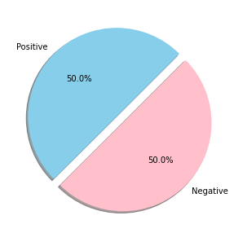
Distribution of target variable for whole dataset

Slide 15
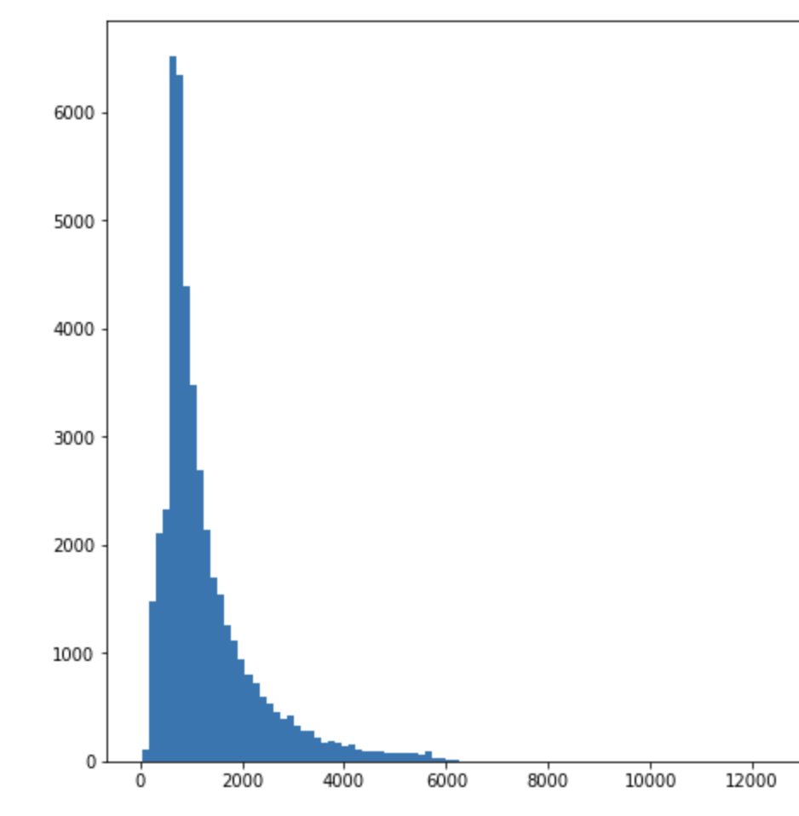
Distribution for number of words in data

Slide 16
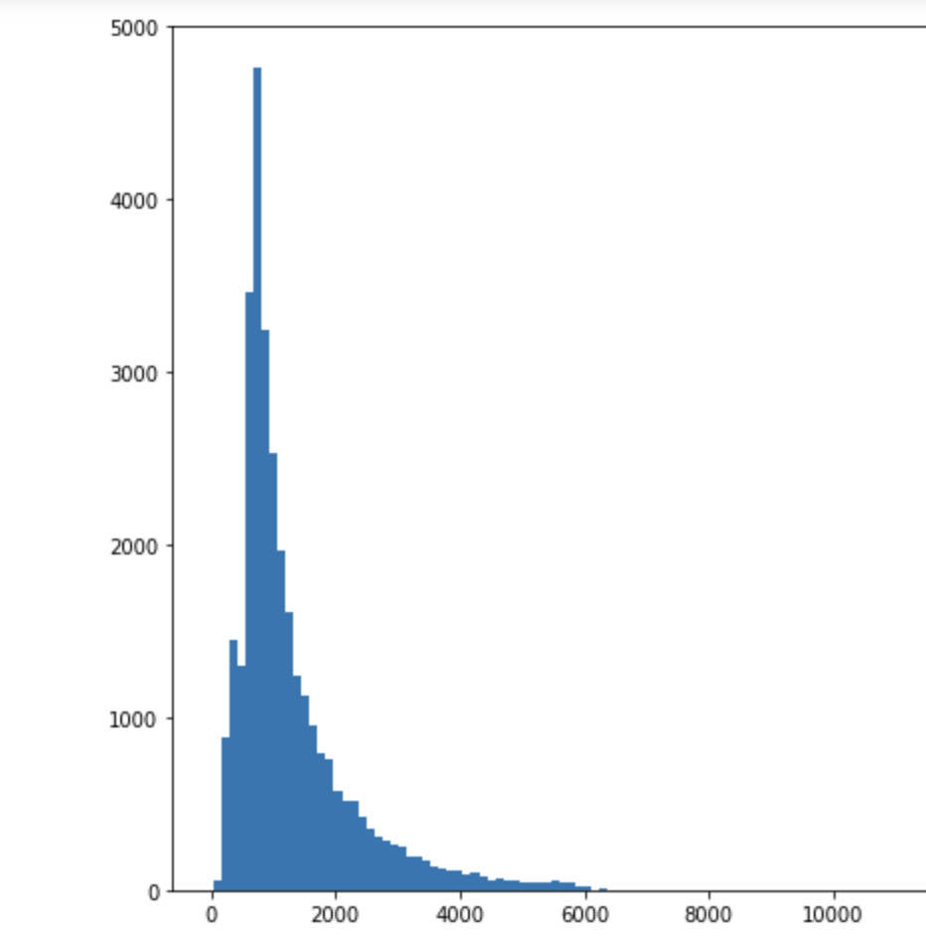
Distribution for number of words in training set

Slide 17
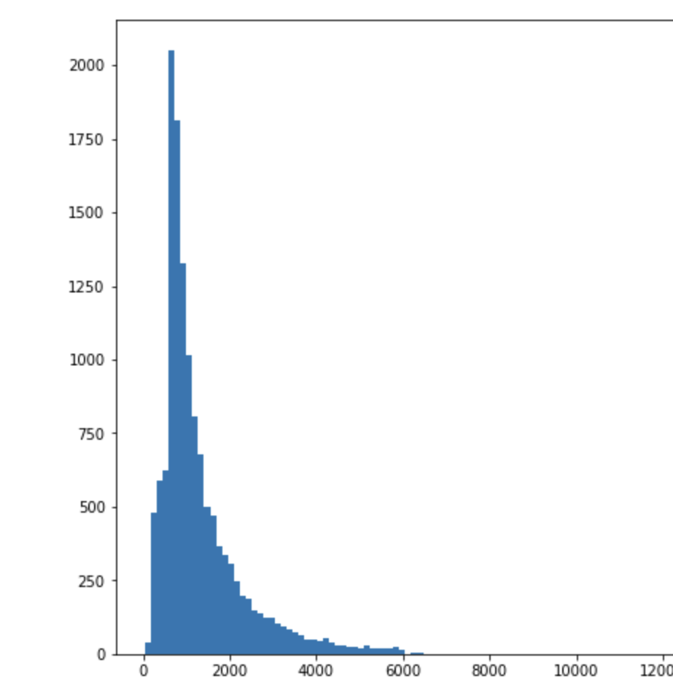
Distribution for number of words in testing set

Slide 18
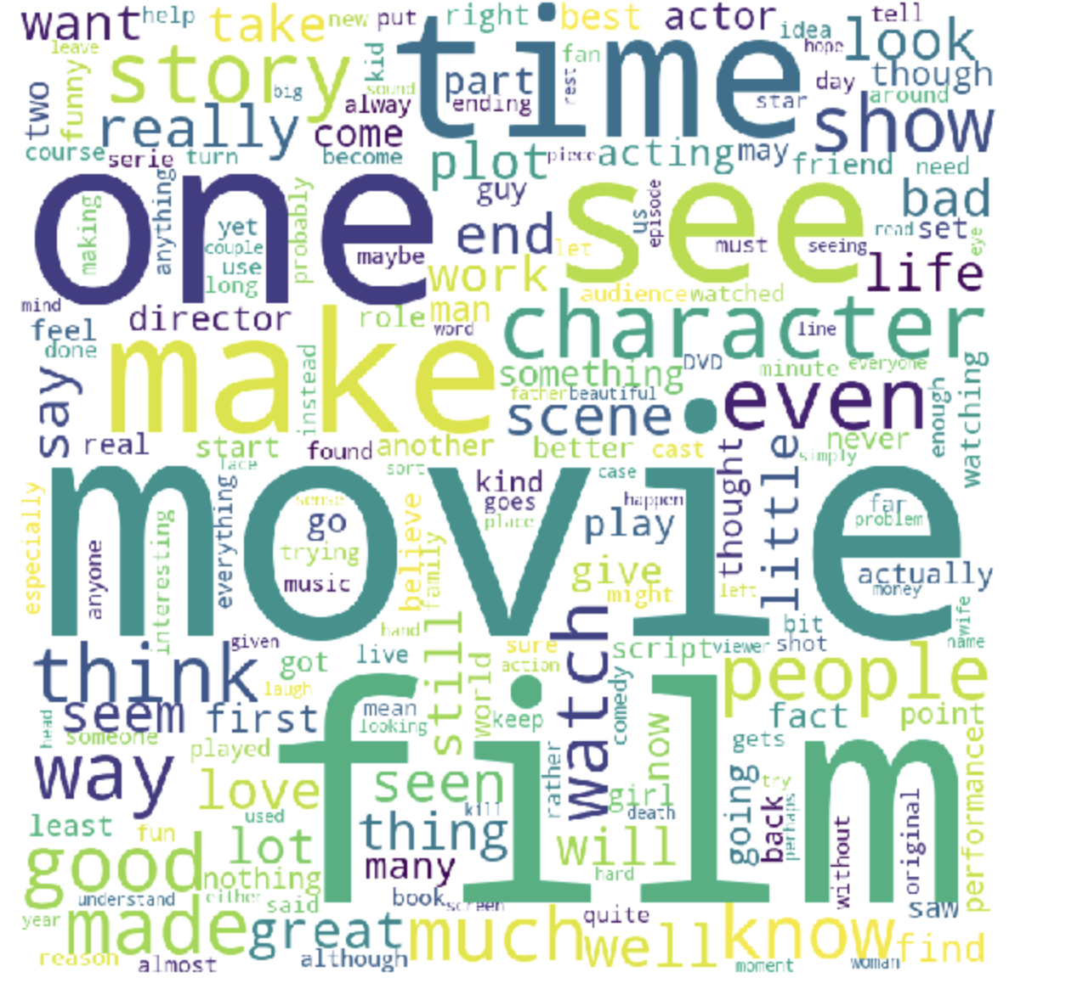
Word Cloud for training data

Slide 19
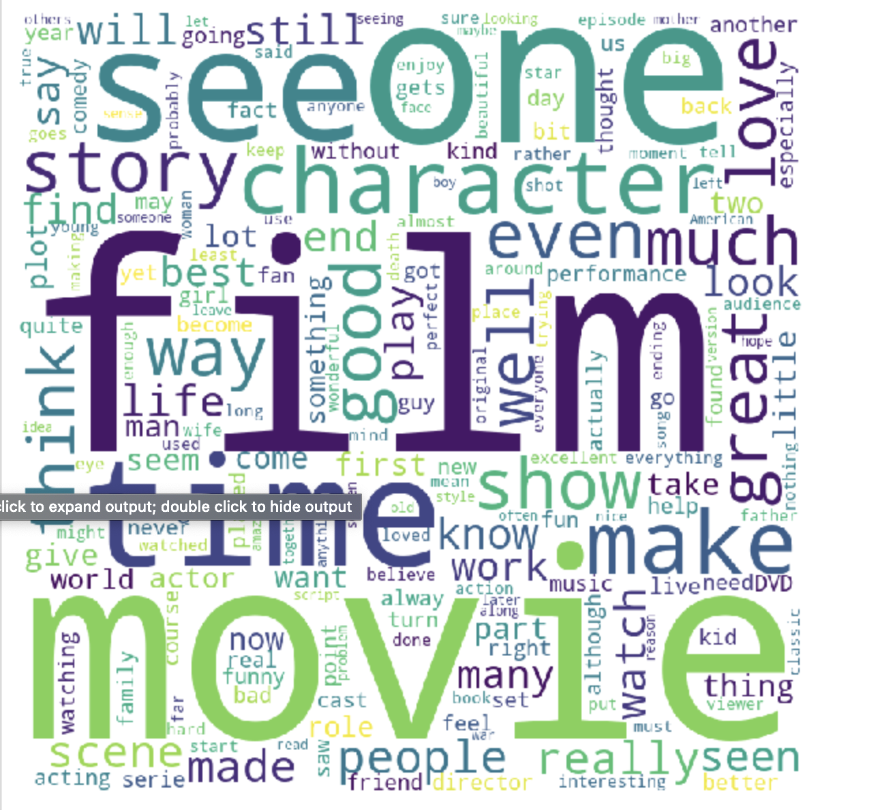
Word Cloud for positive sentences

Slide 20
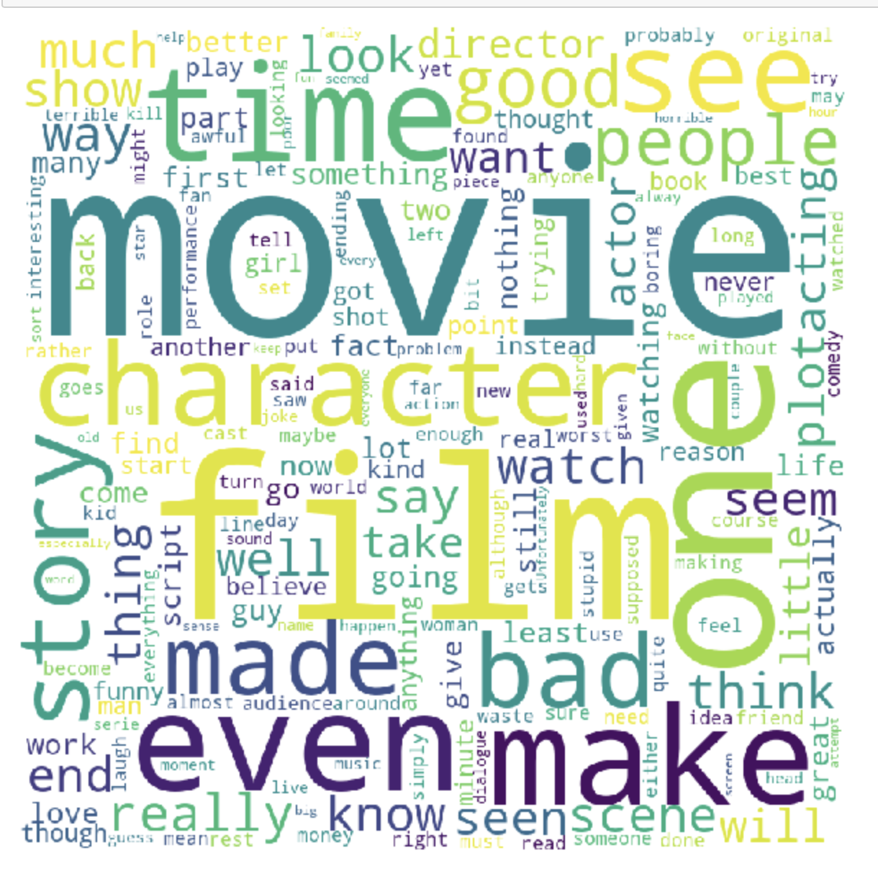
Word Cloud for negative sentences

Slide 21
Model Training Parameters
Vectorizer
Boolean Vectorizer
Count Vectorizer
TFIDF Vectorizer
(n_gram)
Unigram
Bigram
Classification Models
Naïve Bayes
SVM

Slide 22
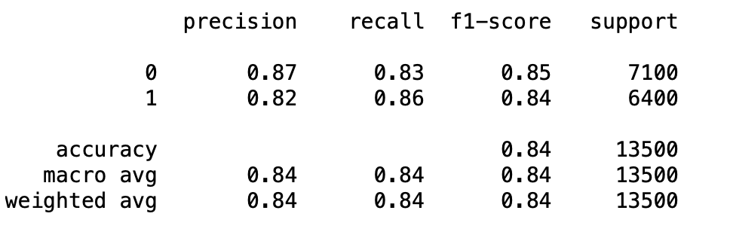
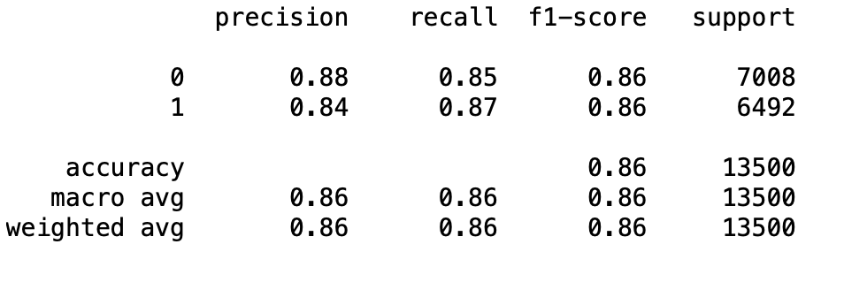
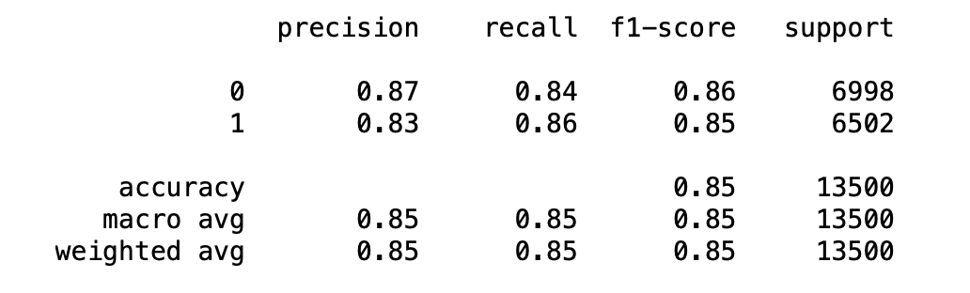
Performance Evaluvation
Unigram Vectorizer + Remove Stop Words + Naïve Bayes
Boolean Count TFIDF

Slide 23
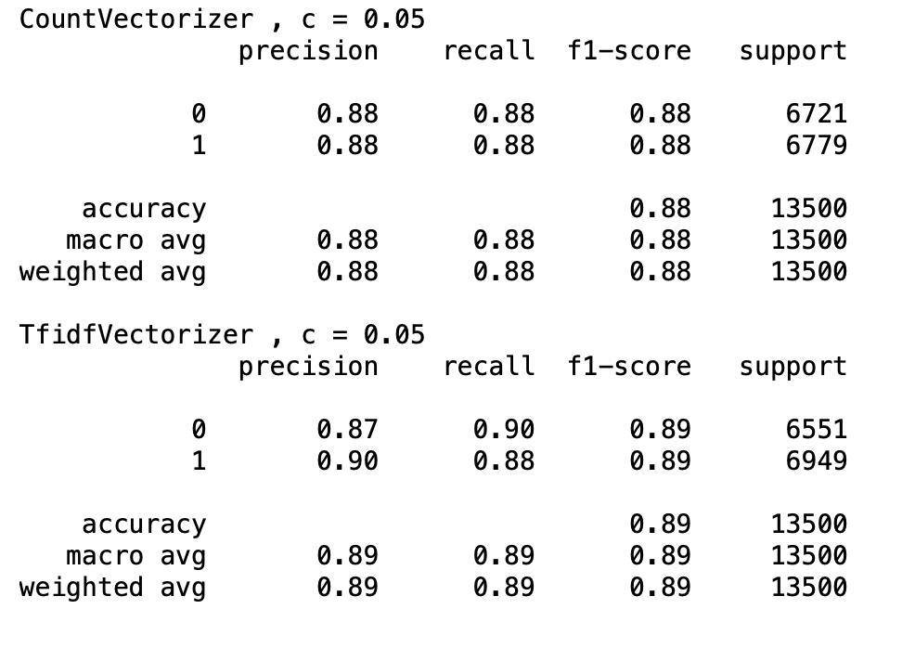
Performance Evaluvation
SVM (C=0.05), Unigram +Stopwords

Slide 24
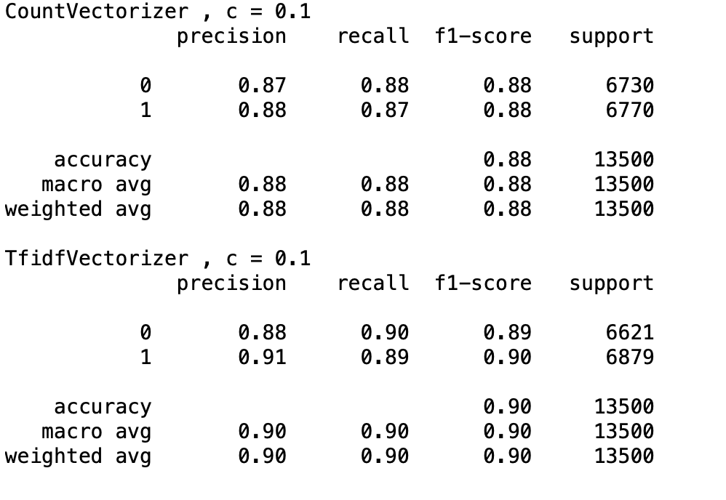
Performance Evaluvation
SVM (C=0.1), Unigram +Stopwords

Slide 25
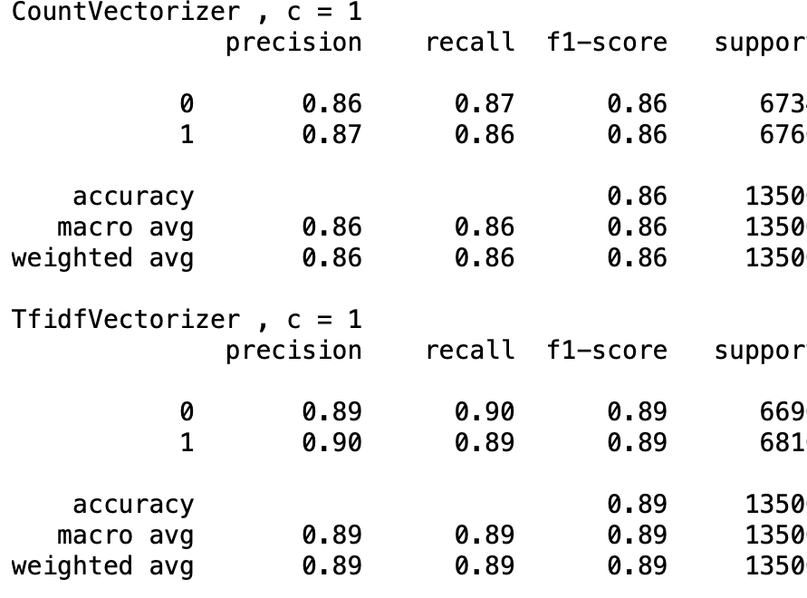
Performance Evaluvation
SVM (C=1), Unigram +Stopwords

Slide 26
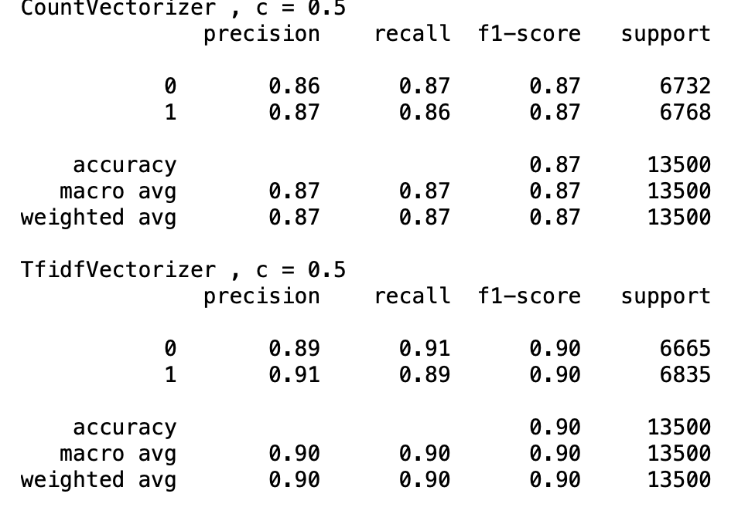
Performance Evaluvation
SVM (C=0.5), Unigram +Stopwords

Slide 27
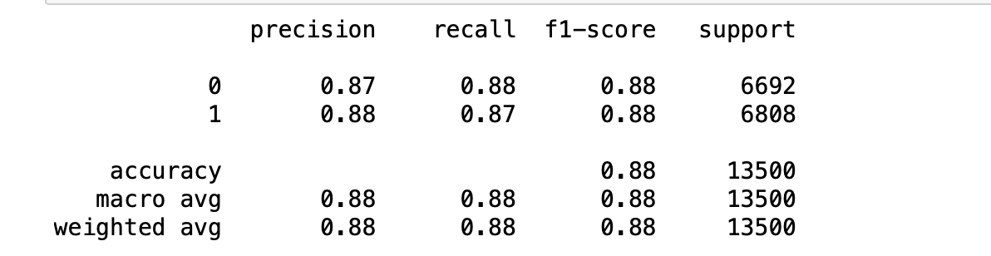
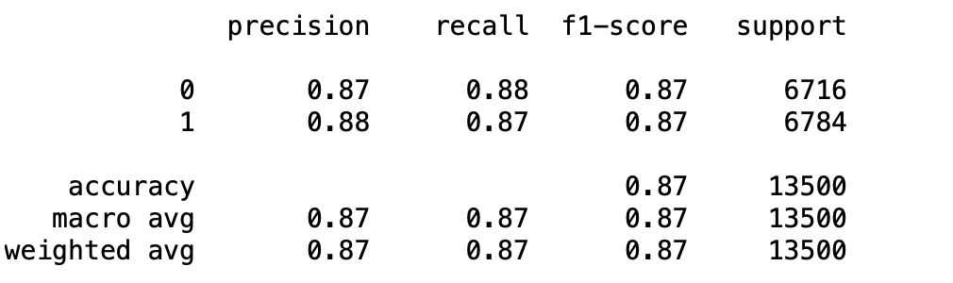
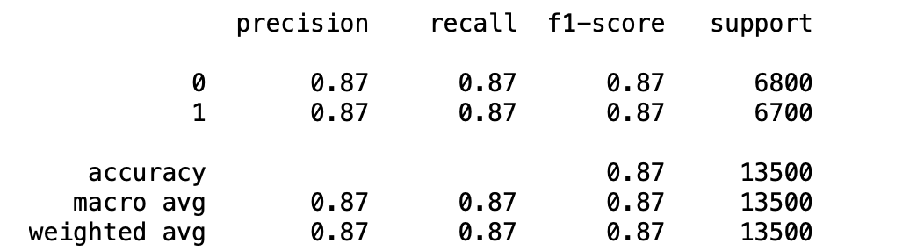
Performance Evaluvation
bigram Vectorizer + Remove Stop Words + Naïve Bayes
Boolean Count TFIDF

Slide 28
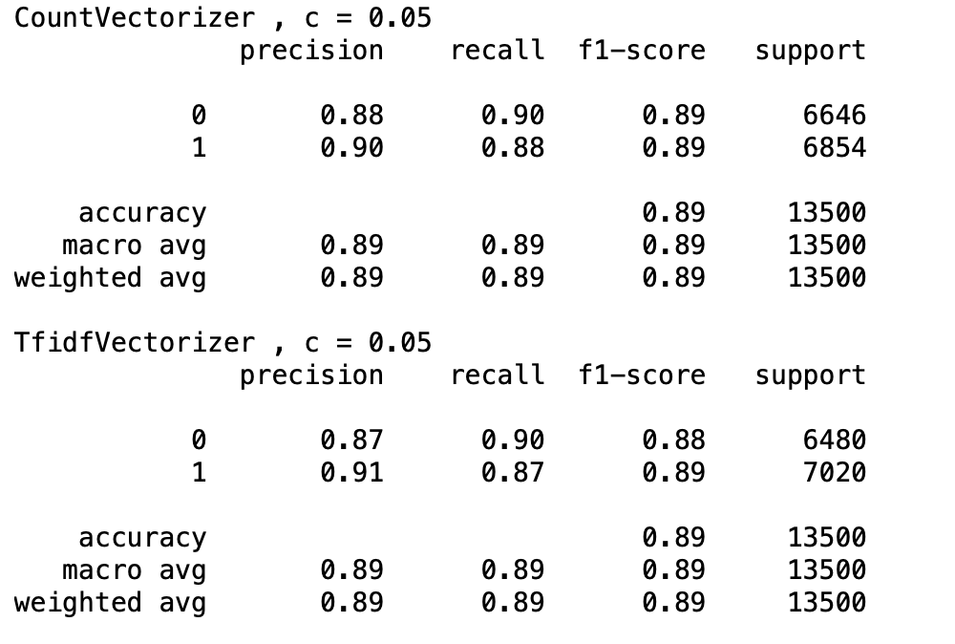
Performance Evaluvation
SVM (C=0.05), bigram +Stopwords

Slide 29
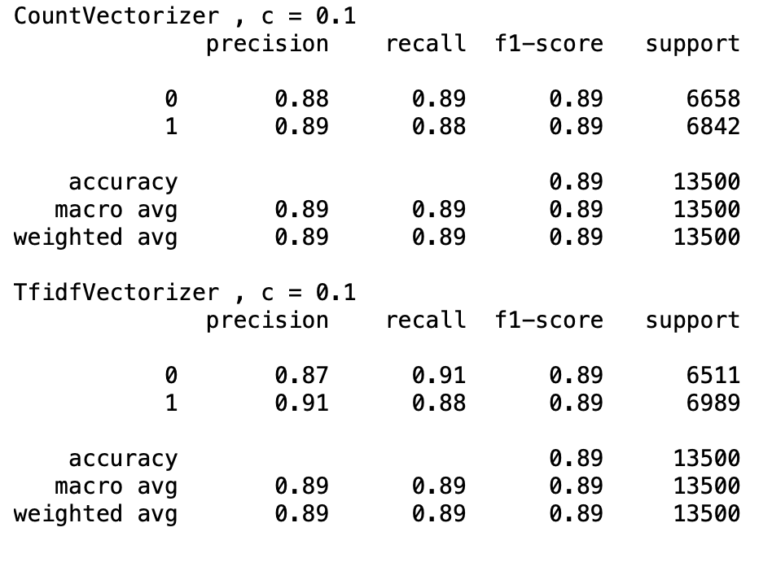
Performance Evaluvation
SVM (C=0.1), bigram +Stopwords

Slide 30
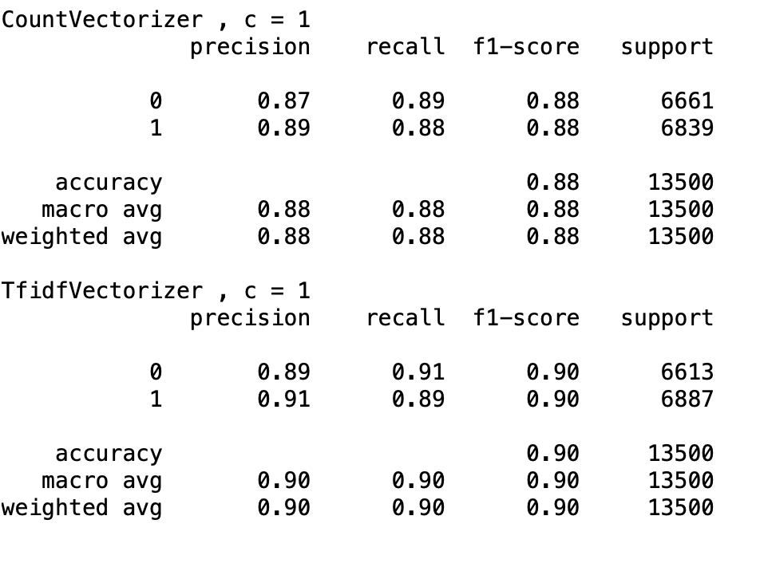
Performace Evaluvation
SVM (C=1), bigram +Stopwords

Slide 31
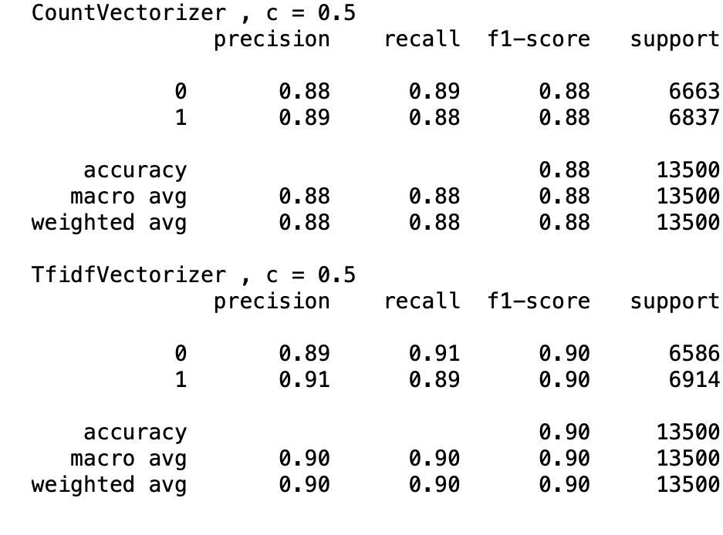
Performance Evaluvation
SVM (C=0.5), bigram +Stopwords

Slide 32

Thank You

